Slide 1
ACHALASIA
THERAPEUTIC APPROACHES

Slide 2
Achalasia ("does not relax") - loss of peristalsis in the distal esophagus and a failure of LES relaxation.

Slide 3
PATHOPHYSIOLOGY
PATHOPHYSIOLOGY
Notes:
Achalasia is a disease of unknown etiology that is characterized by the degeneration of neural elements in the wall of the esophagus. Degenerative changes also can be found in ganglion cells of the dorsal motor nucleus of the vagus in the brainstem, and Wallerian degeneration has been observed in vagal fibers that supply the esophagus. The disordered esophageal motility of achalasia appears to be due primarily to the degeneration and loss of ganglion cells within the esophageal wall, a process that preferentially affects inhibitory neurons. Loss of inhibitory neurons in the LES causes basal sphincter pressures to rise, and renders the sphincter incapable of normal relaxation. In the smooth muscle portion of the body of the esophagus, the loss of intramural neurons results in aperistalsis.

Slide 4
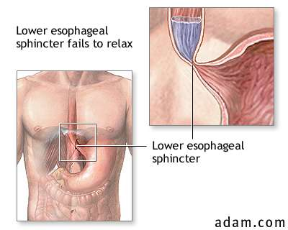

Slide 5
ETIOLOGY
The etiology of achalasia is not known
Autoimmune disorder - associated with HLA-DQw1 - antibodies to enteric neurons
Chronic infections with herpes zoster or measles viruses

Slide 6
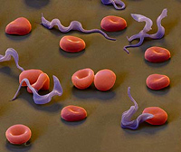
Chagas disease (Trypanosoma cruzi) can result in a loss of intramural ganglion cells leading to aperistalsis and incomplete LES relaxation

Slide 7
CLINICAL MANIFESTATIONS
Dysphagia
Pts may adopt specific maneuvers to aid esophageal emptying:
1)• Standing after eating to enlist aid of gravity
•2) Raising arms after eating to increase the intrathoracic pressure
•3) Use of large amount of water to wash food down
• Recurrent aspiration may result from chronic GER and may lead to pulmonary complications.
• Heartburn more so than GER is complained about, this occurs because of fermentation of retained food in the dilated esophagus
Usually diagnosed between the ages of 25 and 60 years.

Slide 8
Other symptoms:
Chest pain.
Regurgitation.
Dyspepsia .
Weight loss.
Aspiration.
It associated with Increased risk for developing esophageal cancer (squamous cell type)

Slide 9
DIAGNOSIS
radiographic, manometric, and endoscopic evaluation to confirm the diagnosis.

Slide 10
BARIUM SWALLOW Bird’s Beak

Slide 11
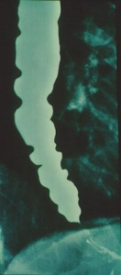
A barium swallow - diagnostic accuracy is approximately 95%
Absence of peristalsis
In some patients, spastic contractions in the esophageal body ("vigorous" achalasia)

Slide 12
Manometry
Elevated resting LES pressure
Incomplete LES relaxation
Peristalsis — or simultaneous contractions

Slide 13
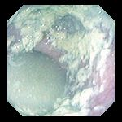
Endoscopy
Exclude malignancies
Dilated esophagus, residual material.
Inflammation and ulceration
Stasis - candida infection.
The LES does not open spontaneously, traversed easily with gentle pressure

Slide 14
Features that suggest malignancy in achalasia
1)short duration of dysphagia.
2)significant weight loss.
3)age older than 60 years

Slide 15
THERAPEUTIC APPROACHES
Four modalities:
• Pharmacotherapy
• Botulinum toxin
• Pneumatic dilation
• Surgical

Slide 16
Pharmacotherapy
– agents that relax SM and theoretically decrease LES pressure.
• Nitrates & calcium channel blockers (CCB)
• Side effects such as headaches and peripheral edema are common.

Slide 17
BALLOON DILATATION
Weaken the LES by tearing its muscle fibers.

Slide 18
BOTULINUM TOXIN
BTX reduce the LES pressure by selectively blocking the release of acetylcholine from presynaptic cholinergic nerve terminals in the myenteric plexus

Slide 19
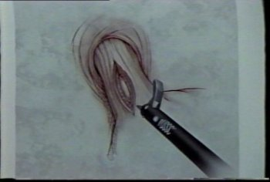
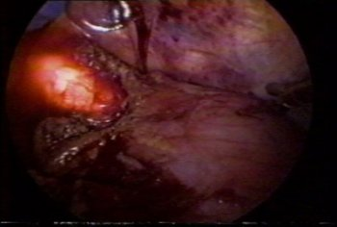
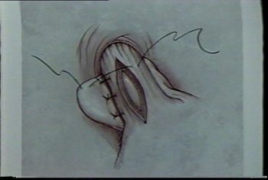
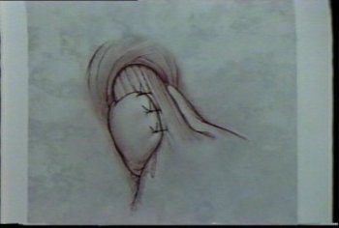
Surgical myotomy

Slide 20
LES is weakened by cutting its muscle fibers down to mucosa
• First described by Ernest Heller in 1914. Originally
was of two myotomies: anterior and posterior.
• Modified Heller myotomy – anterior myotomy ( Dor ).
• Excellent results have been reported in up to 95% of patients in select series.
• Traditionally accomplished by a transthoracic or transabdominal approach.

Slide 21
NEOPLASMS OF THE OESOPHAGUS
Benign tumours
Benign tumours of the oesophagus are relatively rare. True papillomas, adenomas and hyperplastic polyps do occur, but the majority of ‘benign’ tumours are not epithelial in origin and arise from other layers of the oesophageal wall (gastrointestinal stromal tumour (GIST), lipoma, granular cell tumour).
Most benign oesophageal tumours are small and asymptomatic, and even a large benign tumour may cause only mild symptoms

Slide 22
Malignant esophageal Tumors
The vast majority of esophageal cancers are epithelial and fall into one of two types:
1- adenocarcinoma
2- squamous cell carcinoma.
Squamous cell carcinoma generally affects the upper
two-thirds of the oesophagus and adenocarcinoma the lower one-third. Worldwide, squamous cell cancer is most common,
but adenocarcinoma predominates in the West and is increasing in incidence.

Slide 23
Adenocarcinoma
Most esophageal adenocarcinomas arise from Barrett esophagus.
increased rates of esophageal adenocarcinoma
risk factors:
- gastroesophageal reflux/Barrett esophagus
- tobacco use
- Exposure to radiation
risk is reduced by:
- diets rich in fresh fruits and vegetables.
- Some serotypes of Helicobacter pylori

Slide 24
occurs most frequently in Caucasians and shows a strong gender bias, being sevenfold more common in men.
Pathogenesis: Molecular studies suggest that the progression of Barrett esophagus to adenocarcinoma occurs over an extended period through the stepwise acquisition of genetic and epigenetic changes.

Slide 25
Clinical Features:
pain or difficulty in swallowing, progressive
weight loss, hematemesis, chest pain, or vomiting.
occasionally discovered in evaluation of GERD or
surveillance of Barrett esophagus.
As a result of the advanced stage at diagnosis, overall 5-year survival is less than 25%.

Slide 26
Squamous Cell Carcinoma
Risk factors include:
alcohol and tobacco use (polycyclic hydrocarbons, nitrosamines)
Poverty
caustic esophageal injury
Achalasia
Plummer-Vinson syndrome
diets that are deficient in fruits or vegetables
frequent consumption of very hot beverages
Previous radiation to the mediastinum
Human papilloma virus infection has also been implicated in esophageal squamous cell carcinoma in high-risk areas
Fungus contaminated foods.
occurs in adults older than age 45 and affects males four times more frequently than females.

Slide 27
Clinical Features:
- The onset of esophageal squamous cell carcinoma is insidious and it most commonly presents with dysphagia, odynophagia (pain on swallowing), or obstruction.
- weight loss
- Hemorrhage and sepsis may accompany tumor ulceration,
- Occasionally, the first symptoms are caused by aspiration of food via a tracheoesophageal fistula.
- The overall 5-year survival rate in the United States remains less than 20%, and varies by tumor stage and patient age, race, and gender.

Slide 28
spread
Tumours can spread in three ways: invasion directly through the oesophageal wall, via lymphatics or in the bloodstream. Direct spread occurs both laterally, through the component layers of the oesophageal wall, and longitudinally within the oesophageal wall. Longitudinal spread is mainly via the submucosal lymphatic channels of the oesophagus. The pattern of lymphatic drainage is therefore not segmental, as in other parts of the gastrointestinal tract. Consequently, the length of oesophagus involved by tumour is frequently much longer than the macroscopic length of the malignancy at the epithelial surface. Lymph node spread occurs commonly.

Slide 29
Clinical features
Early: non-specific dyspeptic symptoms or a vague feeling of ‘something that is not quite right’ during swallowing. Some are diagnosed during endoscopic surveillance of patients with Barrett’s oesophagus.
dysphagia, but sometimes also regurgitation, vomiting, odynophagia and weight loss.

Slide 30
Late : recurrent laryngeal nerve palsy, Horner’s syndrome, chronic spinal pain and diaphragmatic paralysis. Other factors making surgical cure unlikely include weight loss of more than 20 per cent and loss of appetite.
Cutaneous tumour metastases or enlarged supraclavicular lymph nodes may be seen on clinical examination and indicate disseminated disease. Hoarseness due to recurrent laryngeal nerve palsy is a sign of advanced and incurable disease. Palpable lymphadenopathy in the neck is likewise a sign of advanced disease.

Slide 31
Malignancy - most common cause of pseudoachalasia
Invasion of the esophageal neural plexuses directly, or part of a paraneoplastic syndrome.
Other tumors - esophagus, lung, lymphoma and pancreatic carcinoma
Long term use of gastric band can lead to esophageal dilatation and pseudo achalasia

Slide 32
Investigation
Endoscopy is the first-line investigation for most patients. It provides an unrivalled direct view of the oesophageal mucosa and any lesion allowing its site and size to be documented. Cytology and/or histology specimens taken via the endoscope are crucial for accurate diagnosis.
The chief limitation of conventional endoscopy is that only the mucosal surface can be studied and biopsied. Other investigations are therefore usually required to define the extent of local or distant spread

Slide 33
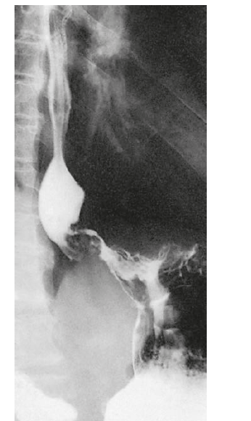
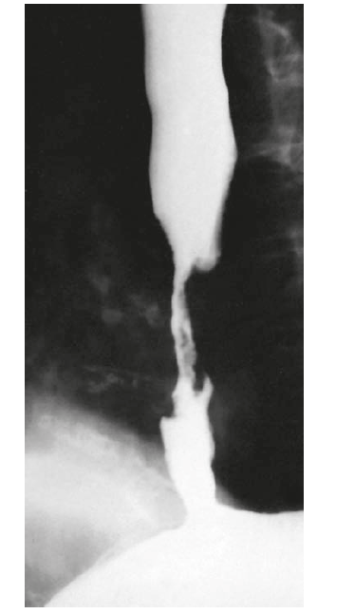

Slide 34
General assessment and staging . Once the initial diagnosis of a malignant oesophageal neoplasm has been made, patients should be assessed first in terms of their general health and fitness for potential therapies.
Transcutaneous ultrasound
It is difficult to visualise mediastinal structures with transcutaneous ultrasound. With the relatively low-frequency sound waves

Slide 35
Bronchoscopy
Many middle- and upper-third oesophageal carcinomas (and therefore usually squamous carcinomas) are sufficiently advanced at the time of diagnosis that the trachea or bronchi are already involved (Figure 62.46). Bronchoscopy may reveal either impingement or invasion of the main airways in over 30 per cent of new patients with cancers in the upper third of the oesophagus.
Laparoscopy
This is a useful technique for the diagnosis of intra-abdominal and hepatic metastases. It has the advantage of enabling tissue samples or peritoneal cytology to be obtained and is the onlymodality reliably able to detect peritoneal tumour seedlings

Slide 36
Computed tomography
Computed tomography scanning is the modality most used to identify haematogenous metastases . Distant organs are easily seen and metastases within them visualised with high accuracy.
Magnetic resonance imaging: adds no benefit to C.T scan.
Endoscopic ultrasound:
can determine the depth of spread of a malignant tumour through the oesophageal wall , the invasion of adjacent organs (T4) and metastasis to lymph nodes can also detect contiguous spread downward into the cardia and more distant metastases to the left lobe of the liver.

Slide 37
Positron emission tomography/computed
tomography scanning
Positron emission tomography (PET) in the context of cancer staging relies on the generally high metabolic activity (particularly in the glycolytic pathway) of tumours compared with normal tissues. The patient is given a small dose of the radio pharmaceutical agent 18F-fluorodeoxyglucose (FDG).

Slide 38
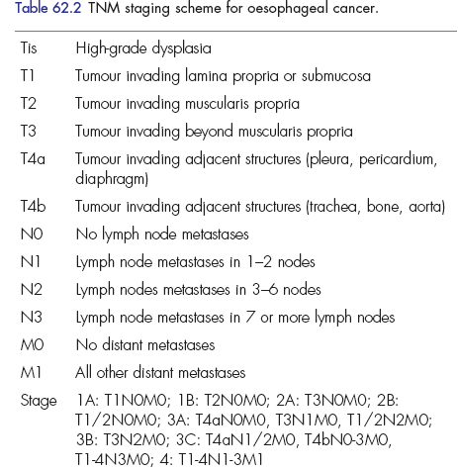

Slide 39
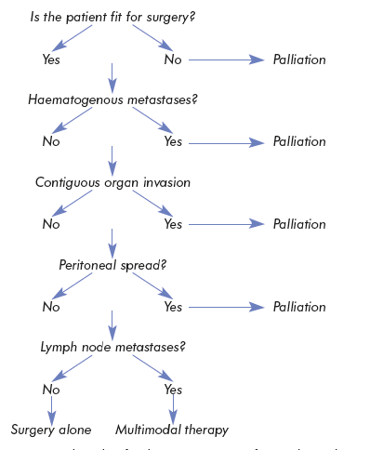
Treatment of malignant tumors

Slide 40
Principles
At the time of diagnosis, around two-thirds of all patients with oesophageal cancer will already have incurable disease.
The aim of palliative treatment is to overcome debilitating or distressing symptoms while maintaining the best quality of life possible for the patient. Some patients do not require specific therapeutic interventions, but do need supportive care and appropriate liaison with community nursing and hospice care services.

Slide 41
As dysphagia is the predominant symptom in advanced oesophageal cancer, the principal aim of palliation is to restore adequate swallowing. A variety of methods are available and ,given the short life expectancy of most patients.

Slide 42
Curative surgery
The principle of oesophagectomy is to deal adequately with the local tumour in order to minimize the risk of local recurrence and achieve an adequate lymphadenectomy to reduce the risk of staging error.
When such a margin cannot be achieved proximally, particularly with squamous cell carcinoma, there is evidence that postoperative radiotherapy can minimize local recurrence

Slide 43
Adenocarcinoma commonly involves the gastric cardia and may therefore extend into the fundus or down the lesser curve.
Some degree of gastric excision is essential in order to achieve adequate local clearance and accomplish an appropriate lymphadenectomy.
Excision of contiguous structures, such as crura,
diaphragm and mediastinal pleura, needs to be considered as a method of creating negative resection margins.

Slide 44
Recent advances
Endoscopic mucosal resection for these apparently early lesions has become increasingly popular, providing either a cure or at least sufficient histological information upon which to base a further management strategy.
Photodynamic therapy (PDT) is an alternative approach that has largely been used in patients who were either unfit or unwilling to undergo surgery. This endoscopic technique relies on the administration of a photosensitiser that is taken up preferentially by dysplastic and malignant cells followed by exposure of an appropriate segment of the esophagus to laser light. The main drawback is skin photosensitization, so patients must avoid sunlight exposure in the short term.

Slide 45
summary
Radical oesophagectomy is the most important aspect of curative treatment
Neoadjuvant treatments before surgery may improve survival in a proportion of patients
Chemoradiotherapy alone may cure selected patients, particularly those with squamous cell cancers
Useful palliation may be achieved by chemo/radiotherapy or endoscopic treatments

Slide 46
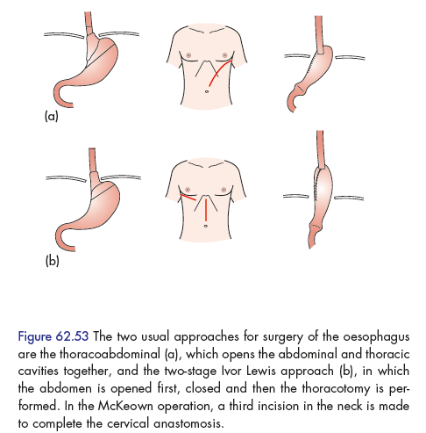
Esophagectomy
3)Transhiatal oesophagectomy (without thoracotomy)

Slide 47
Esophageal Obstruction
Structural (mechanical) obstruction
Functional obstruction (disruption of the coordinated waves of peristaltic contractions) --------- Esophageal dysmotility

Slide 48
Esophageal dysmotility:
- Nutcracker esophagus:
- Diffuse esophageal spasm:
- Lower esophageal sphincter dysfunction/hypertensive lower esophageal sphincter

Slide 49
Nutcracker esophagus:
High-amplitude contractions of the distal esophagus---- contractions proceed in a coordinated manner
dysphagia, chest pain

Slide 50
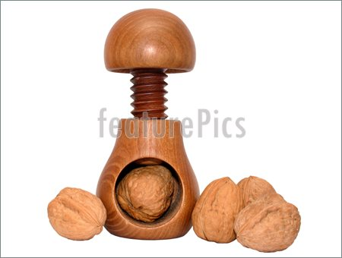

Slide 52
esophageal motility study (esophageal manometry)
Esophageal motility studies involve pressure measurements of the esophagus after a patient takes a wet (fluid-containing) or dry (solid-containing) swallow. Measurements are usually taken at various points in the esophagus

Slide 53
Diffuse esophageal spasm:
repetitive, simultaneous contractions of the distal esophageal smooth muscle -----uncoordinated contractions of the esophagus , contractions that are of normal amplitude
Dysphagia, chest pain
DX by manometry

Slide 54
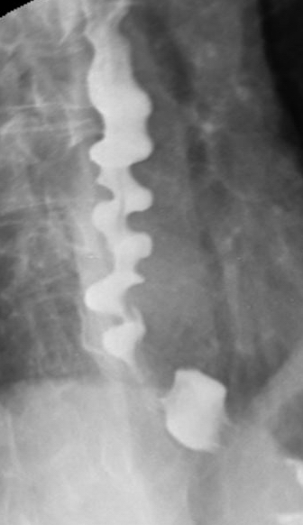
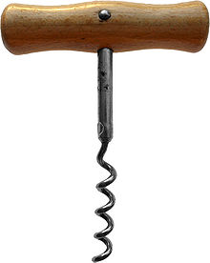
Corkscrew appearance of the esophagus, Barium swallow

Slide 55
Mechanical obstruction:
presents as progressive dysphagia that begins with inability to swallow solids ----- liquids .
can be caused by:
1- strictures/stenosis (chronic gastro-esophageal reflux, irradiation, caustic injury, cancer)
2- Cancer
3- Esophageal mucosal webs :
- idiopathic
- 4- Esophageal rings, or Schatzki rings

Slide 56
Lower esophageal sphincter dysfunction:
- such as high resting pressure or incomplete relaxation.
- Termed hypertensive lower esophageal sphincter in absence of altered patterns of esophageal contraction that seen in disorders described above.

Slide 57
esophageal dysmotility may result in development of diverticula:
Epiphrenic diverticulum (above the lower esophageal sphincter)
Zenker diverticulum/pharyngoesophageal diverticulum (above the upper esophageal sphincter)----------- if large ---- accumulation of food ------ mass, regurgitation and halitosis.

Slide 58
Plummer–Vinson syndrome
This is also called the Paterson–Kelly syndrome or sideropenic
dysphagia. The original descriptions are vague and poorly supported
by evidence of a coherent syndrome. Dysphagia is said
to occur because of the presence of a postcricoid web that is
associated with iron deficiency anaemia, glossitis and koilonychia.

Slide 59
A 41-year-old man complains of regurgitation of saliva and of undigested
food. An esophagram reveals a dilated esophagus and a bird’s-beak
deformity. Manometry shows a hypertensive lower esophageal sphincter
with failure to relax with deglutition. Which of the following is the safest
and most effective treatment of this condition?
a. Medical treatment with sublingual nitroglycerin, nitrates, or calcium-channel
blockers
b. Repeated bougie dilations
c. Injections of botulinum toxin directly into the lower esophageal sphincter
d. Dilation with a Gruntzig-type (volume-limited, pressure-control) balloon
e. Surgical esophagomyotomy

